Slide 1

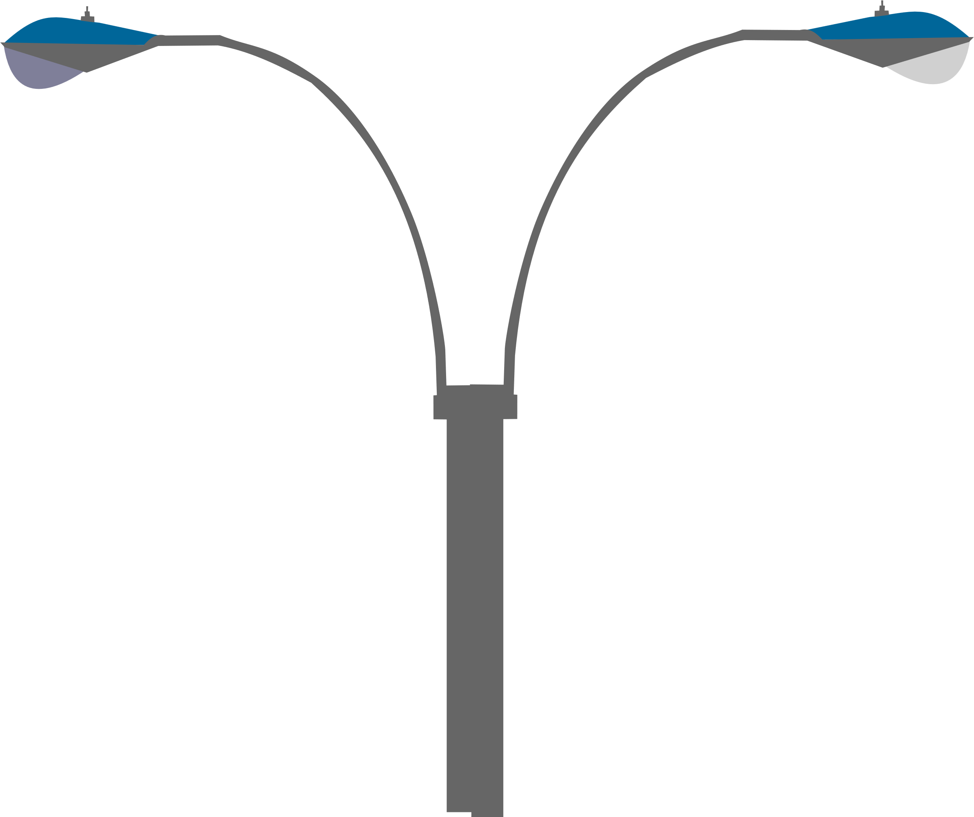

CtrlLights
AI-Powered Traffic Lights for Smarter, Faster Roads

Slide 2


TABLE OF CONTENTS
01.
Project Overview
What is the project about?
02.
Implementation
How we created it?
03.
Conclusion
What are the final insights and future steps?

Slide 3

01.
PROJECT OVERVIEW

Slide 4

PROBLEMS
Traffic Congestion
Pollution Increase
Overloaded roads lead to delays and inefficiency.
Idling vehicles contribute to air pollution.

Slide 5






SCOPE OF WORK
Integrated Raspberry Pi 5 for traffic analyzation
Air Quality Sensor
Camera control
which is feeding the algorithm data

Slide 6


02.
IMPLEMENTATION

Slide 7
Objective 1
Objective 4
Develop a Deep Learning Algorithm for traffic flow.
Implement the new AI-powered traffic lights
Objective 2
Objective 5
Create a web platform for traffic light control and monitoring
Improve the AI with the gathered data
Objective 3
Objective 6
Build a mobile app for users.
Expand the system and integrate with smart cities

Slide 8


The time saved on average
Amount of pollution reduced
Reduction in fuel consumption

Slide 9






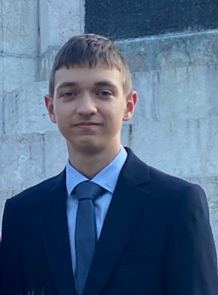
PROJECT TEAM
Konstantin
Violinov
Kaloyan
Nikolov
Preslav
Tsvetanov
Atanas
Chobanov
Mert
Elsenev
Lead Engineer
Lead Designer
Helper Engineer
Lead Backend
Developer
Helper Backend/
Mobile App Developer
Ivan Georgiev
Velislav Donchev
Lead Frontend
Developer
Helper Frontend Developer

Slide 10


03.
CONCLUSION

Slide 11

Efficiency & Impact
The system will significantly improve traffic flow by dynamically adjusting traffic lights based on real-time congestion data

Slide 12


Expanding further in bigger cities
Scaling for widespread impact.
Creating a network of these systems
Enhancing connectivity for smoother traffic.
Implementation in small cities
PROJECT TIMELINE
Pilot phase to test efficiency.

Slide 13
Thank You for Your Time and Attention
Ctrllights.onrender.com

